Slide 1
Windows Desktop Applications
Windows WPF Applications

Slide 2
New Direction
Windows Forms
In the past
Most of what you learn will still apply.
Windows Presentation Framework (WPF)
XML based
Notes:
In the past we have used windows form applications this semester we will be doing WPF applications. Most of what you will learn regarding WPF applications can easily be applied to Windows Form Applications.

Slide 3
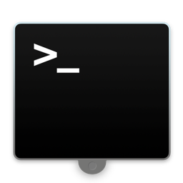


Windows WPF Applications are GUI
Text based Interface
GUI – Graphical User Interface
Buttons
Shapes
Icons
Cursors
Button

Slide 4
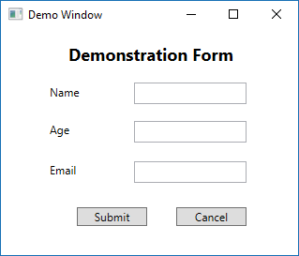
Window Form Example
Form Object
Control Objects
Click Event occurs when button is clicked
Form and Control Objects Have:
Properties (Attributes)
Methods
Events

Slide 5
Common WPF Controls
Border
Button
CheckBox
ComboBox
Grid
Image
Label
ListBox
RadioButton
Rectangle
StackPanel
TextBlock
TextBox

Slide 6

Common WPF Controls – Details 1
Border
For placing borders and graphics around controls
Rectangle
Draw rectangles
Image
Place images on the form

Slide 7
Common WPF Controls – Details 2
Label
Provide non-editable text to identify objects on the form
TextBlock
Show large bodies of text that are modified in code
TextBox
Allow users to provide input to the program
Name Field
Text output from code
Text Entered Here|

Slide 8
Common WPF Controls – Details 3
Button
User clicks these to made code happen
CheckBox
When multiple items may be selected for a choice
RadioButton
When only one item may be selected in a group
Submit Form
Option 1
Option 2
Option 3
Option 1
Option 2
Option 3

Slide 9
Common WPF Controls – Details 4
ComboBox
Selectable list of items where only one item can be selected.
ListBox
Selectable list of items where multiple items can be selected.
Option 1
Option 1
Option 2
Option 3
Option 4

Slide 10
Common WPF Controls – Details 4
Layout-Based Controls
Grid
Contains Rows and Columns
StackPanel
Places controls vertically or horizontally

Slide 11
Common Properties 1
Name
identifies control in code
Text
Text content of the control
often what is displayed to the user
Content
What the control contains
Visibility
Control is hidden or visible

Slide 12
Common Properties 2
Text
Settings for Text appearance
In XAML
FontFamily
Name of Font (Arial, Times New Roman, etc.)
FontSize
Size of Font (pixels [default]; pt to specify point font)
FontWeight
Bold, Normal, Light, etc.
FontStyle
Italics, etc.

Slide 13
Common Properties 3
Background
background color of control
Foreground
Color of text in control
Enabled/isEnabled
control can be activated/deactivated
Height/Width
Size of control in X and Y coords
Auto – calculated based off of margins
Margin
Top, Left, Right, and Bottom distances from parent control edges

Slide 14
Common Properties 4
TabIndex
Zero-based index
user can navigate the focus on a form by using the tab key
identifies the order the control has in the tab sequence
TabStop
set to true if control can receive the focus by using the tab key - otherwise false

Slide 15
Some Control Methods
Clear()
e.g. clear text in a text box
Focus()
e.g. set focus to a control
Show()
e.g. show a form
Close()
e.g. close a form

Slide 16
Name Conventions
Prefix - camel case meaningful name, started with the prefix for the type of control
Examples:
txtName
rbGender
lbSports
btnCalculateTax
chkIsRealBig
lblNameTitle

Slide 17
Naming Convention shortNames
TextBox – txt
TextBlock - tb
Label – lbl
RichTextBox – rtb
CheckBox – chk
RadioButton - rb
Button – btn
DropDownList – ddl
ListBox -lb
ComboBox – cmb
ListItem – li
TreeView – tv
PictureBox – pb
Image – img
GroupBox – gb
Border – brd
Frame – frm
Grid – grd
StackPanel – stk
ViewBox – vb
Canvas – can
MenuItem – mi
ToolTip – tt
Timer – tmr

Slide 18
Naming Conventions 2
Variables do not need type
intHeightOfTower is not needed
Instead just the name
heightOfTower will be fine

Slide 19
Common Events
Click
e.g. a button's Click event
TextChanged
e.g. the text in a text box has been changed
SelectedIndexChanged
e.g. the user has selected a different item in a list or combo box
CheckedChanged
e.g. the user has changed the selection of a radio button or check box
MouseEntered
Mouse cursor is over the control

Slide 20
Hints for Assignment 2
Threading
Mono-Spaced Fonts

Slide 21
GUI Threads
ThreadPool.QueueUserWorkItem((o) => {
// This is a Lambda, do not worry what it does yet.
while (iteration < 100) {
Dispatcher.Invoke(new Action(MethodToCall));
Thread.Sleep(100); // pauses the thread
}
});

